Slide 1
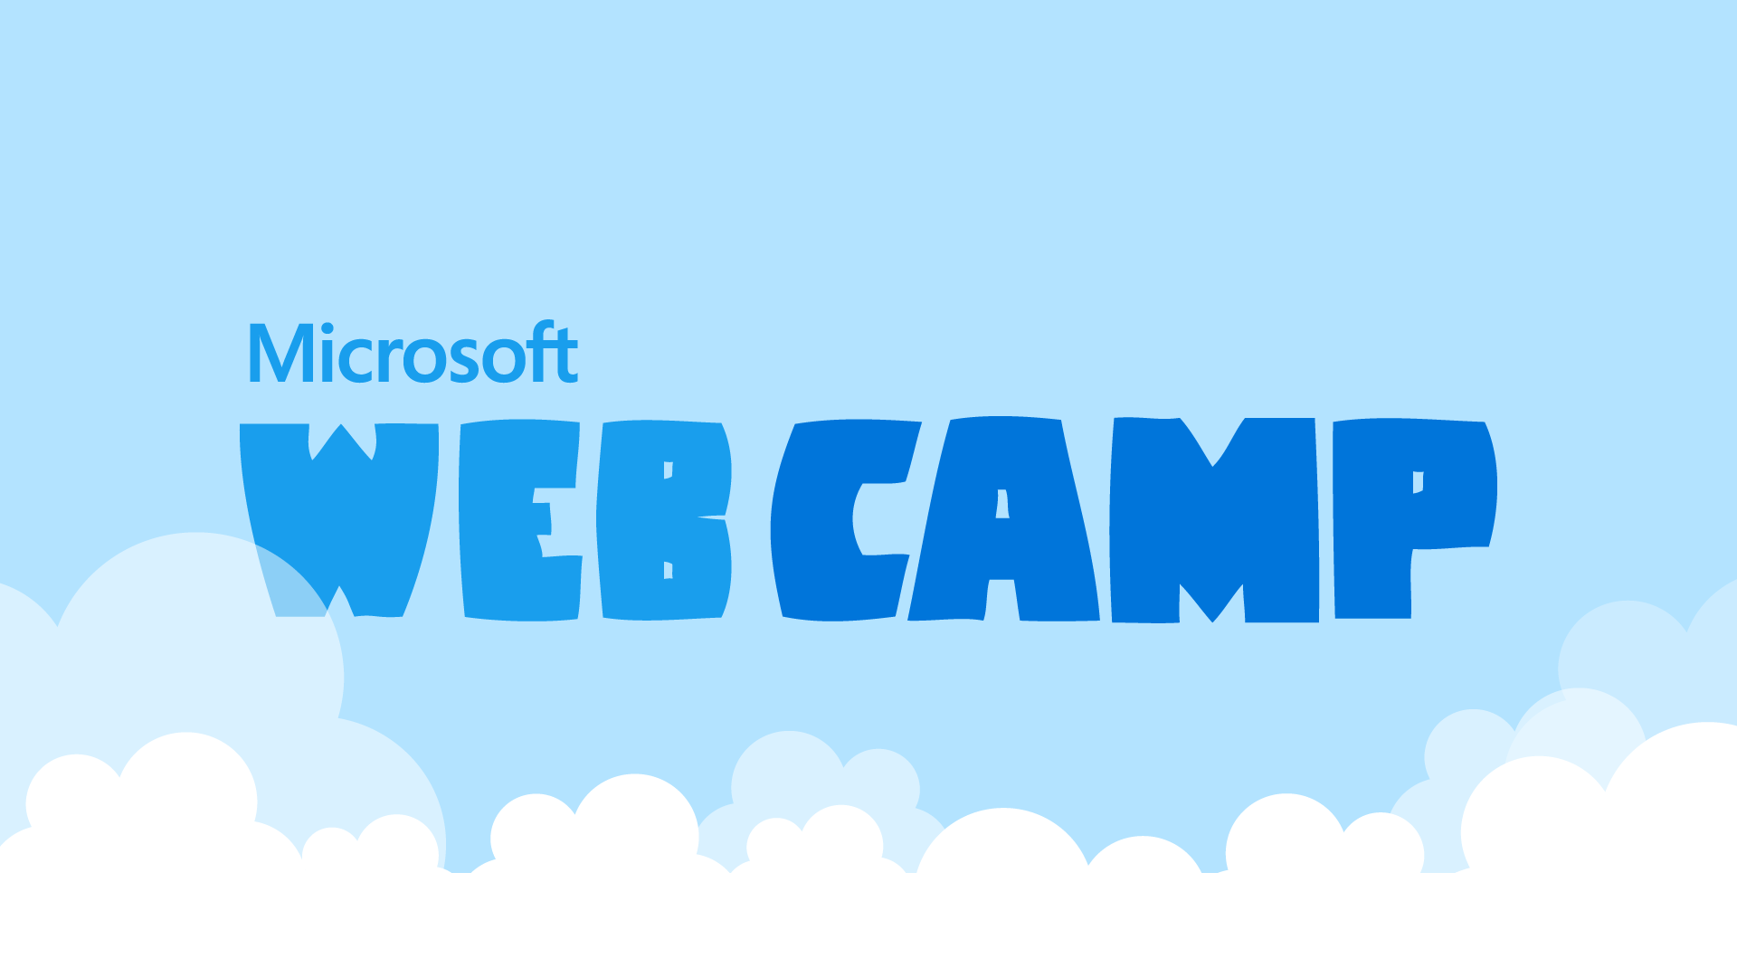
Microsoft Azure Logic Apps
#mswebcamp

Slide 2







About me
Sandro Pereira
Senior Software Developer | Microsoft Azure MVP
sandro.pereira@devscope.net
linkedin.com/in/sandropereira
@sandro_asp
sandroaspbiztalkblog.wordpress.com
+351 223 751 350
www.devscope.net

Slide 3



Agenda
Integration Challenges
Challenges can be overwhelmed
Microsoft Integration Stack
From BizTalk Server to Azure BizTalk Services
Microsoft Azure Logic Apps
Introduction to Microsoft Azure App Service
Logic Apps and API Apps (preview) Overview and roadmap

Slide 4


Inconsistent
Information
Massive Number of endpoints
Different protocols
Two many systems
Incompatible Systems
Long running operations
monitoring & management
fault tolerant
Different data formats
Challenges
Overwhelmed?
Need to Scale
ALWAYS ON
retry mechanisms, persistence, backup channels
Notes:
Sobrecarregado, esmagador

Slide 5
Microsoft Integration - The Cloud on Your Terms
Connect to the Cloud
Connect your Existing apps to the cloud
Build out your business without building new datacenters
Run in the Cloud
Run existing integrations in the cloud without re-write
Clear up on-prem infrastructure capacity; provision in minutes not weeks
Build for the Cloud
Design and build your new integration solutions to take full advantage of Platform as a Service
Connect to SaaS to SaaS and to on-prem

Slide 6
Microsoft Integration - The Cloud on Your Terms
Connect to the Cloud
BizTalk Server 2013/2013 R2
Run in the Cloud
BizTalk Server 2013/2013 R2 in Microsoft Azure
Build for the Cloud
Microsoft Azure BizTalk Services
Microsoft Azure App Service*
* Still in preview

Slide 7



BizTalk Server - “The T-Rex is Loose”
Cloud Services
Suppliers Application
servers
EDI
RFI
databases
Microsoft BizTalk Server 2013 R2
Up-to-date KPIs in BAM
Filter Tags
Policy
Read Shipment RFID Tags
Manage and
Operate
Storage
Re-stock Orders
Orchestration
Custom Application
Assign Supplier
Policy
applications
Messaging
Design and Implement
mainframe
Inventory Application
ERP Application
Your Data Center
on premise “king” platform integration
Notes:
Traditional app integration
Enterprise apps installed in a local datacenter
Specialized BizTalk server integrated common enterprise apps
Few touch points with tight coupling
Traditional trading partnerships
Fixed set of B2B protocols/schemas
Lengthy partner onboarding
Crossing enterprise boundaries through firewalls
Hard to do resource planning to adjust for seasonal demands

Slide 8

Bring the Cloud to your Enterprise: Infrastructure
Microsoft Azure
Active Directory
SharePoint
SQL Server
BizTalk Server 2003/2003 R2
Virtual Network
Your Data Center
Storage
databases
applications
servers
mainframe
Microsoft BizTalk Server 2013 R2
Notes:
Two major ways to bring cloud compute to your enterprise:
First is at the infrastructure level:
Virtual network,
WA AD
System Center
Cloud backup for SQL Server
Windows Server
etc.

Slide 9
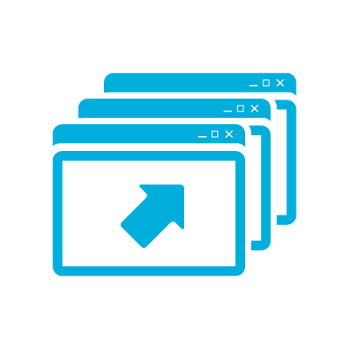
Bring the Cloud to your
Enterprise: Integration
Microsoft Azure
SaaS
Apps
Partners
BizTalk Service
Service Bus
Your
Data Center
BizTalk Server
BizTalk Adapter Service
applications
mainframe
servers
databases
Notes:
Another key way to use the cloud is though integration.
Windows Azure provides a great environment for running web apps and public facing services.
Also a great “DMZ” for connecting with partners.
EAI Service
Drag and drop integration solution development
Out of the box support for common integration patterns
Connectivity to on-premises LOB systems out of the box
EDI - B2B Service
Trading partner management and supplier on-boarding
Support for X12 and AS2
Extensible Platform
Rich message processing
Customization with code for transforms and pipeline stages
Trading Partner Management API for custom experiences

Slide 10
Microsoft Azure Logic Apps
Introduction to Microsoft Azure App Service
Logic Apps and API Apps (preview) Overview and roadmap

Slide 11

Microsoft Integration Build for the Cloud
Azure App Service
Unique integrated offering
Build rich, engaging & intelligent apps
Scale as your business grows
Azure Websites
Mobile Services
BizTalk Services
Key app services in Azure today
* Still in preview

Slide 12
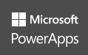

Microsoft Azure App Service
One integrated offering
Web Apps
Mobile Apps
Web apps that scale with your business
Build Mobile apps for any device
Nov 30, 2015
Azure App Services
PowerApps Annouced
LOGIC Apps
Api Apps
Automate business process across SaaS and on-premises
Easily build and consume APIs in the cloud
* Still in preview

Slide 13
Runtime and development
Will provide scalability
Cross platform
Auto update
Deep logging diagnostics
Rich ecosystem with partner monetization opportunities
Will be available on premises with Windows Azure pack
* Still in preview

Slide 14
Complete web + mobile experiences
Rich PaaS offer with cross-platform for .NET, Java, node.js, PHP…
Built-in autoscale and load balance
High availability and auto-patching
Continuous integration and DevOps
* Still in preview

Slide 15
Microsoft Azure API Apps
Expose your application to 50+ popular SaaS API’s and Share your API in your organization
All triggers and actions use inside Logic Apps are API Apps
Easily use cloud or custom APIs:
Dozens of built-in APIs for popular SaaS
An ecosystem of APIs for any need
Create and publish custom, reusable APIs
Visual Studio tooling with one click publish and remote debugging
Automatic client SDK generation for many languages
API Apps
Create, consume and
host APIs more easily
* Still in preview
Notes:
Key scenarios:
Integrate with SaaS and Enterprise applications
Generate client proxies or API’s in your language of choice
Automate versioning and deployment of API Apps
Secure API’s with Active Directly, Single Sign-on, and OAuth
Share API’s internally with Organizational gallery

Slide 16
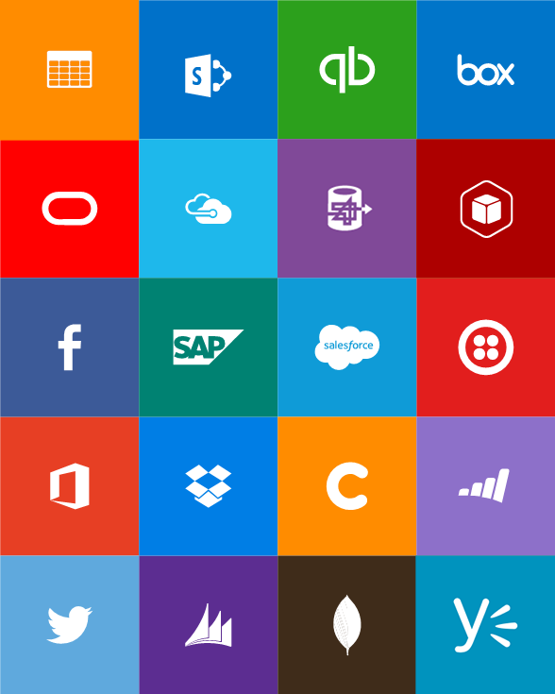
Microsoft Azure Built-in API
Connectors
Box
Chatter
Delay
Dropbox
Azure HD Insight
Marketo
Azure Media Services
OneDrive
SharePoint
SQL Server
Office 365
Oracle
QuickBooks
SalesForce
Sugar CRM
SAP
Azure Service Bus
Azure Storage
Timer / Recurrence
Twilio
Twitter
IBM DB2
Informix
Websphere MQ
Azure Web Jobs
Yammer
Dynamics CRM
Dynamics AX
Hybrid Connectivity
Protocols
BizTalk Services
HTTP, HTTPS
File
Flat File
FTP, SFTP
POP3/IMAP
SMTP
SOAP + WCF
Batching / Debatching
Validate
Extract (XPath)
Transform (+Mapper)
Convert (XML-JSON)
Convert (XML-FF)
X12
EDIFACT
AS2
TPMOM
Rules Engine
* Still in preview

Slide 17
Microsoft Azure Logic Apps
Logic Apps is a new service offered by Microsoft Azure. It allows users to easily create and manage a flow of triggers and actions.
It enable you to develop and deliver powerful integration solutions with ease.
Triggers start when an event happens, it can be periodic triggers or triggers based on an arrival of an Email, … when a trigger kicks in, the actions specified in the Logic App are invoked.
Logic Apps for easy automation
Browser based “workflow” engine
No code designer for rapid creation
Dozens of pre-built templates to get started
Out of box support for popular SaaS and on-premises apps - pre-built connectors
Use with custom API apps of your own
BizTalk APIs for expert integration scenarios
Provides in-built support for tracking
Logic Apps
Automate SaaS and
on-premises systems
* Still in preview
Notes:
Key scenarios:
Visually create business processes and workflows
Deliver integration capabilities in Web, Mobile and API apps
Integrate with your SaaS and enterprise applications
Automate EAI/B2B and business process
Connect to On-premises data

Slide 18

How BizTalk fits in Azure App Services
basic features comparison
Health
Monitor
BRE
Pipelines
Orchestrations
BAM
Maps
Adapters
AZURE
portal
+
Api Apps
LOGIC Apps
Easily build and consume APIs in the cloud
Automate business process across SaaS and on-premises
Power bi
* Still in preview

Slide 19
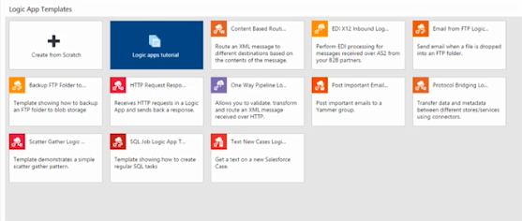
Recent Additions to Logic Apps
Easier to get started
Improved debugging + control
Templates
Search in the Gallery
Tooltips
Key Integration Areas
Better content handling
More connectivity
Better administration
Notes:
Add several templates
This template contain prewire triggers and actions all that you have to do is config
Search API gallery
New Tooltips for you to see what inputs and outputs are

Slide 20
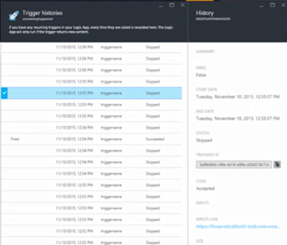
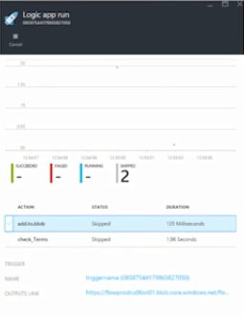
Recent Additions to Logic Apps
Easier to get started
Trigger history
Output and Correlation
Retry Policy
Override Async Behavior
Improved debugging + control
Key Integration Areas
Better content handling
More connectivity
Better administration
Notes:
Triggers history for a better debug - See a current triggers as run
Full inputs and outputs are
Customize retry policy
Customize Retry policy
Override Async Behavior – fire and forget

Slide 21
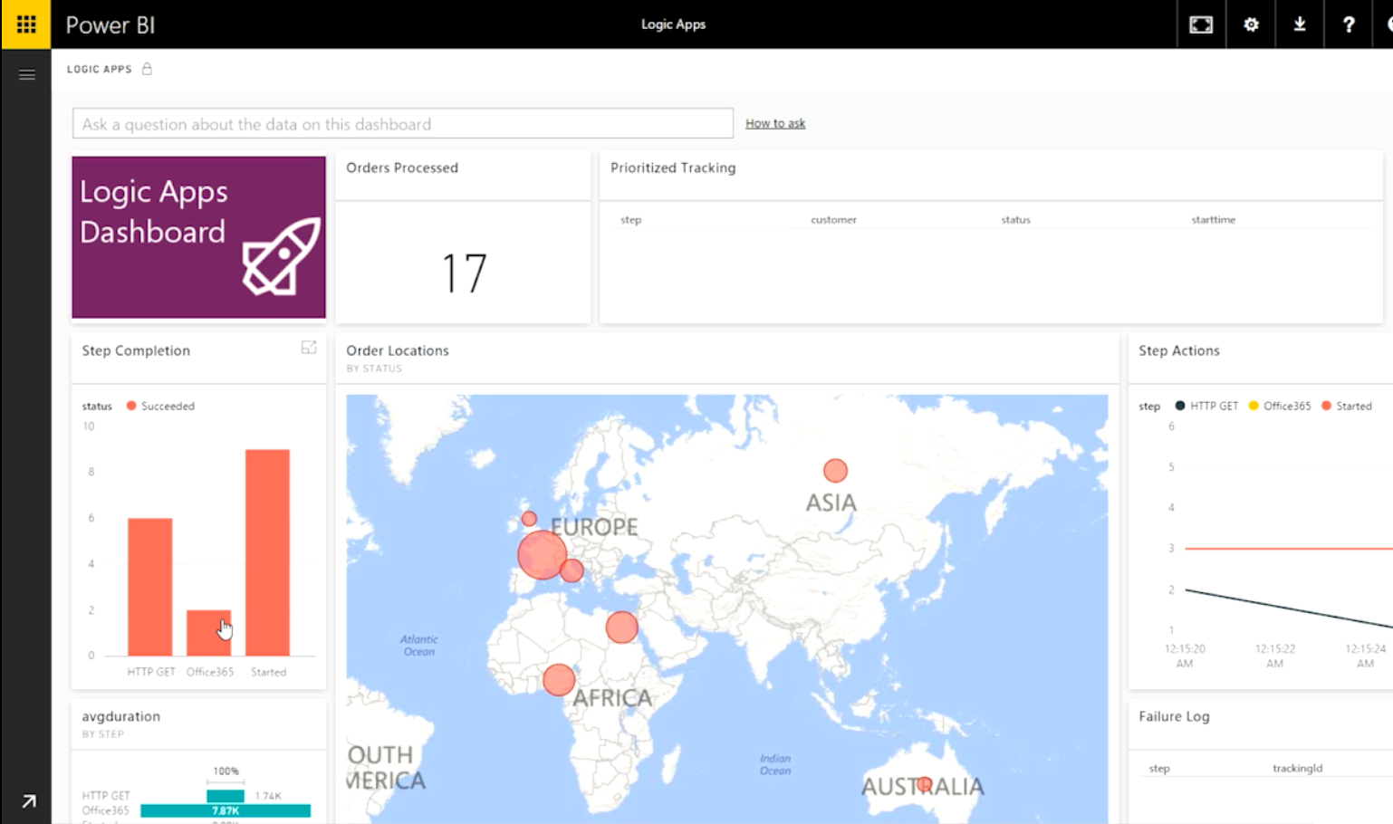
Recent Additions to Logic Apps
Easier to get started
Build-your-own Business Insights
Scheduling in the future
Including TimeZone support
Control flow
Do-until
Wait Action
Trigger Message Splitter
Improved debugging + control
Key Integration Areas
Better content handling
More connectivity
Better administration
Notes:
Integrate with PowerBI so you can build your own activity dashboard
Debatch message

Slide 22
Recent Additions to Logic Apps
Easier to get started
Binary content
This can be used for copying content between APIs
Parsing JSON strings
Improved debugging + control
Key Integration Areas
Better content handling
More connectivity
Better administration
Notes:
Better parsing JSON strings

Slide 23

Recent Additions to Logic Apps
Easier to get started
14 different connectors
3 built in to the Azure marketplace
11 in the GitHub repository
Improved debugging + control
Key Integration Areas
Better content handling
More connectivity
Better administration

Slide 24
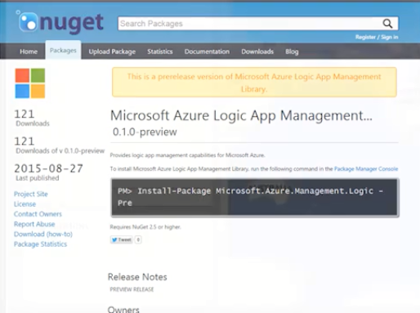
Recent Additions to Logic Apps
Easier to get started
Rename and move
Manual triggers
.NET SDK11 in the GitHub repository
Improved debugging + control
Key Integration Areas
Better content handling
More connectivity
Better administration
Notes:
Rename or move Logic Apps

Slide 25
#LogicApp
Demo

Slide 26
What’s Coming Next?
Webhooks
Register the Logic apps endpoints with other services
Schema validation for incoming requests
Static endpoint independent of Sub ID and resource group Name
Action in the middle of the flow
Hosting Custom APIs
New Logic App Designer
Notes:
Key scenarios:
Visually create business processes and workflows
Deliver integration capabilities in Web, Mobile and API apps
Integrate with your SaaS and enterprise applications
Automate EAI/B2B and business process
Connect to On-premises data

Slide 27
What’s Coming Next?
Webhooks
Logic Apps designer will support any API endpoint with Swagger
Best integration with App Service API Apps + Easy Auth (not required)
Adding API Management capabilities for the APIs that you use from Logic Apps
Build your APIs with any technology, such App Service Web Apps
Get the same full-fidelity experience as you have today, but with ALL endpoints
Hosting Custom APIs
New Logic App Designer
Notes:
Key scenarios:
Visually create business processes and workflows
Deliver integration capabilities in Web, Mobile and API apps
Integrate with your SaaS and enterprise applications
Automate EAI/B2B and business process
Connect to On-premises data

Slide 28
What’s Coming Next?
Webhooks
Read from top to bottom (previous from left to right)
Similar to what we have today in BizTalk Server
Search across all triggers and actions (APIs available)
Will be able to call the new API Apps
Authorization will be improved
And many more
Hosting Custom APIs
New Logic App Designer
Notes:
Key scenarios:
Visually create business processes and workflows
Deliver integration capabilities in Web, Mobile and API apps
Integrate with your SaaS and enterprise applications
Automate EAI/B2B and business process
Connect to On-premises data

Slide 29
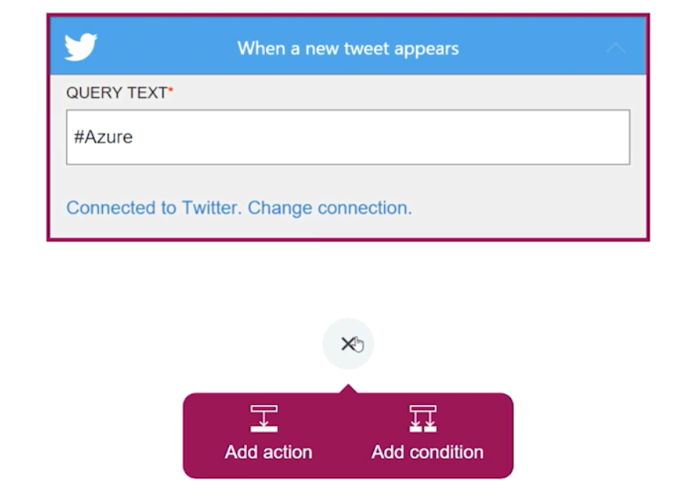
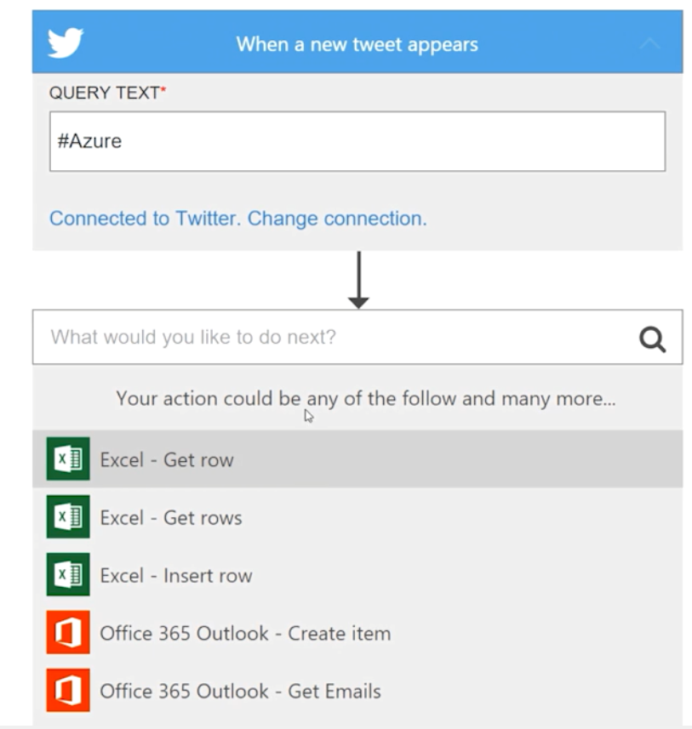
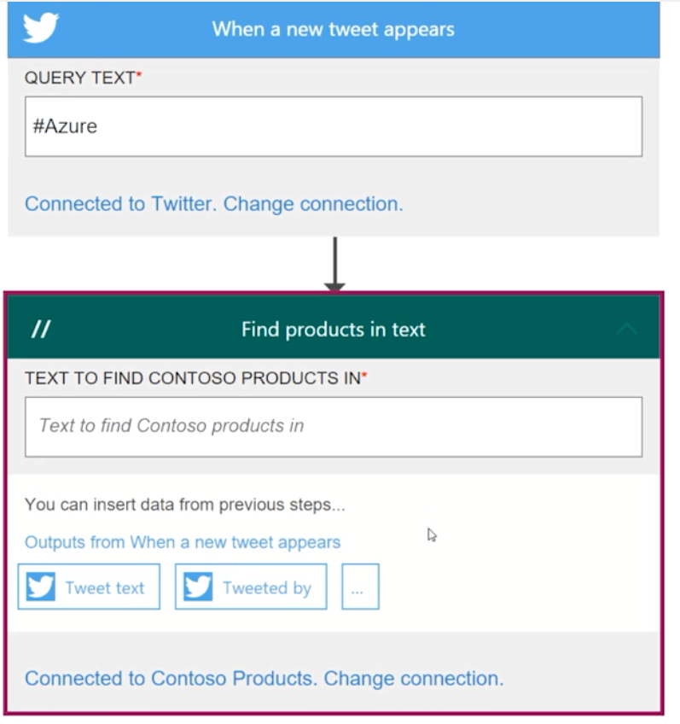
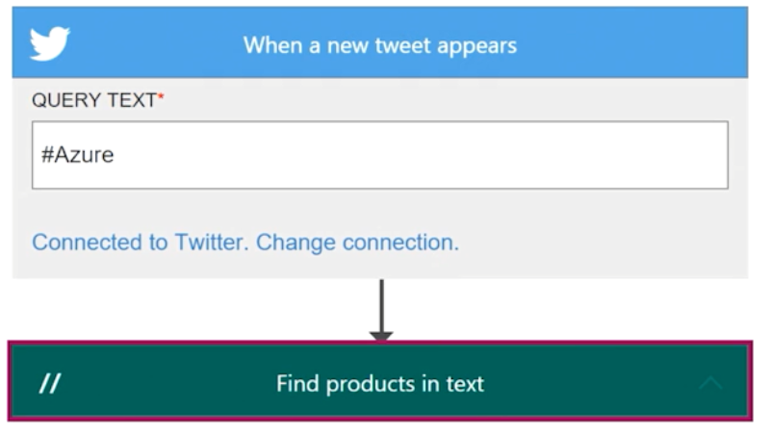
What’s Coming Next?
Webhooks
Hosting Custom APIs
New Logic App Designer
Notes:
Key scenarios:
Visually create business processes and workflows
Deliver integration capabilities in Web, Mobile and API apps
Integrate with your SaaS and enterprise applications
Automate EAI/B2B and business process
Connect to On-premises data

Slide 30

Integration Roadmap
BizTalk Server
2010
BizTalk Server
2013
BizTalk Server
2013 R2
BizTalk Server
2016
A new major release each 2 years
A new minor release (R2) each 2 years
~15 years, ~15,000 customers
9th release
~3 months after
SQL Server 2016
Azure Service Bus
EAI and EDI Labs
Beta
BizTalk Services
GA
Dez, 2011
Nov, 2013
Azure App Services
Logic Apps update
Azure App Services
Logic App Preview
March, 2015
2016 Q1
Nov 30, 2015
Azure App Services
PowerApps Annouced

Slide 31
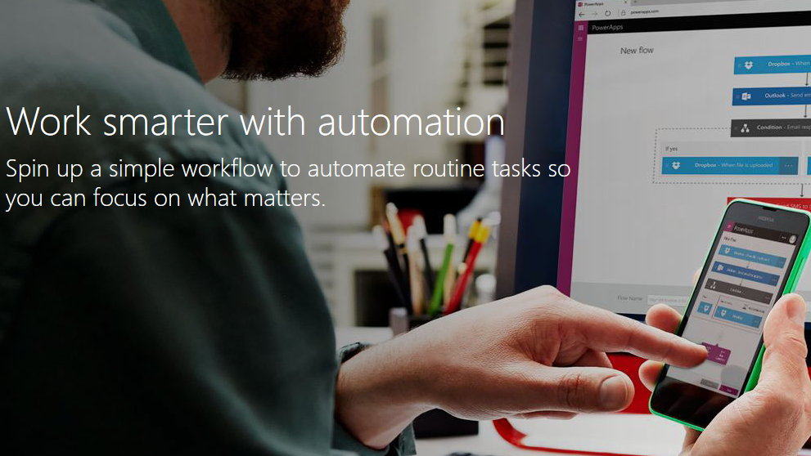
Microsoft Azure PowerApps
https://powerapps.microsoft.com/en-us/

Slide 32
Try it today!
Logic Apps Monthly Video Sessions
http://aka.ms/logicappslive
Logic Apps Documentation
https://azure.Microsoft.com/documentation/services/app-service/logic/
Try App Service
https://tryappservice.azure.com/
PowerApps Request Invite
https://powerapps.microsoft.com/en-us/

Slide 33
Questions?
Sandro Pereira
Senior Software Developer | Microsoft Azure MVP
sandro.pereira@devscope.net
linkedin.com/in/sandropereira
@sandro_asp
sandroaspbiztalkblog.wordpress.com
+351 223 751 350
www.devscope.net

Slide 34


Slide 36


Thanks!

